Slide 1
Parallel Lines cut by a Transversal
Angles inside and outside triangles
Triangle Inequality Theorem
Auxiliary Lines
Angle Side Relationships
100
100
100
100
100
200
200
200
200
200
300
300
300
300
300
400
400
400
400
400

Slide 2
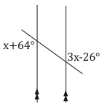
What value of x makes the two lines parallel?

Slide 3
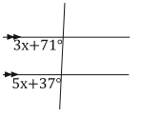
What value of x makes the two lines parallel?

Slide 4
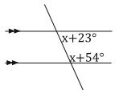
What value of x makes the two lines parallel?

Slide 5
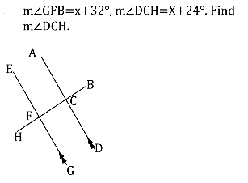

Slide 7
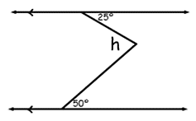
What is the value of <h?

Slide 8
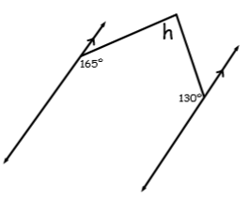
What is the value of <h?

Slide 9
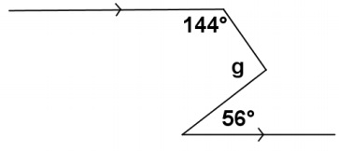
Find the measure of <g.

Slide 10
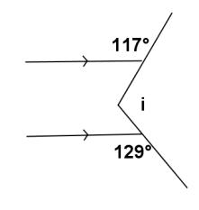
Find the measure of <i.

Slide 12
What is the measure of the smallest angle?

Slide 13
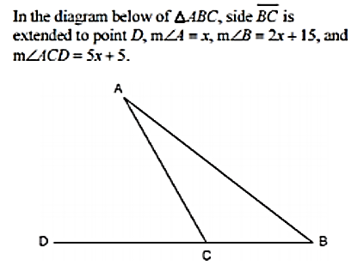
A
D
B
C
What is the measure of <B?

Slide 14
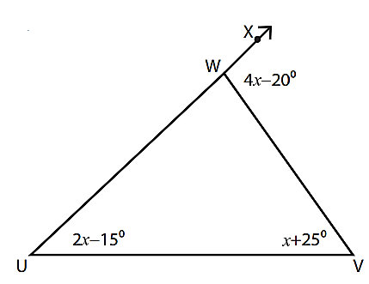
What is the measure of <WUV?

Slide 15
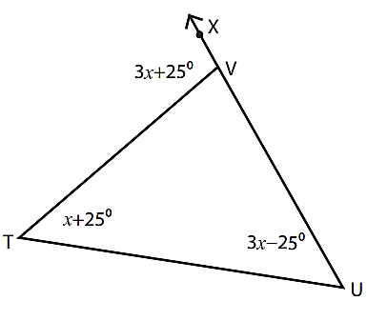
‘
‘
‘
What kind of triangle is TUV?

Slide 17
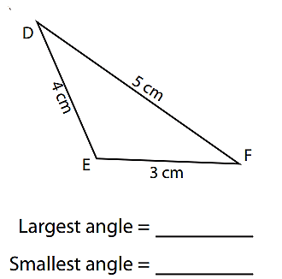

Slide 18
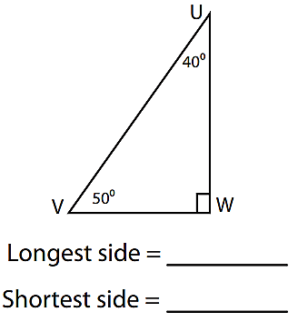

Slide 19
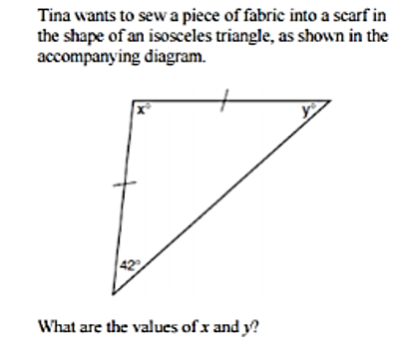

Slide 20
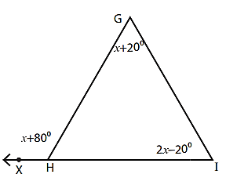
What is the smallest side of triangle GHI?

Slide 22
A. {7, 5, 4} B {2, 3, 6}
For which set can the three numbers be the measures of the sides of a triangle? Why?

Slide 23
A. {5, 2, 4} B {2, 8, 1}
For which set can the three numbers be the measures of the sides of a triangle? Why?

Slide 24
Name a third possible side that would create a triangle given the side lengths 5 and 9.

Slide 25
