Slide 1
Observing Mechanisms

Slide 2
What is a mechanism?
A mechanism is a device that transmits ____________ so that the motion is different than the _________ motion.
It can be used to change the ________________, ____________, __________, or type of movement.

Slide 3
Important Definitions
Mechanism -
Input -
Force -
Gear -

Slide 4
Gears!
A gear train is a mechanism used for transmitting ________________ and ___________.
Gears transmit rotary motion through interlocking teeth. A gear train is made when ______ or more gears are meshed.
Meshed gears always turn in ________________________.

Slide 5
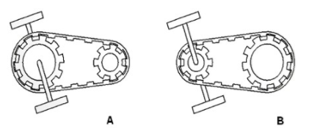
Gear Ratios
Gear ratios can be determined using the ____________________ on the gear or the ______________ of the gear.
Gears turn in a circular direction. There is an __________ relationship between torque and speed in gearing. A twenty seven-speed bicycle has 27 different gear selections. When you pedal up a hill, you use a gear train that provides more torque (turning force) but, in doing so, less speed.

Slide 6
Torque
What happens to speed when you increase torque?
What happens to torque when you increase speed?

